Slide 1

E-Commerce Website
FRONT-END
PROJECT
Presented by: Aditya Bhatt
Roll No: 2110990084
Group No: 5
Submitted To - Mr. Lavish Arora

Slide 2
OVERVIEW
01
02
03
Introduction
Why was this name chosen
Goals
04
05
06
Challenges
Project Overview
Future Scope

Slide 3
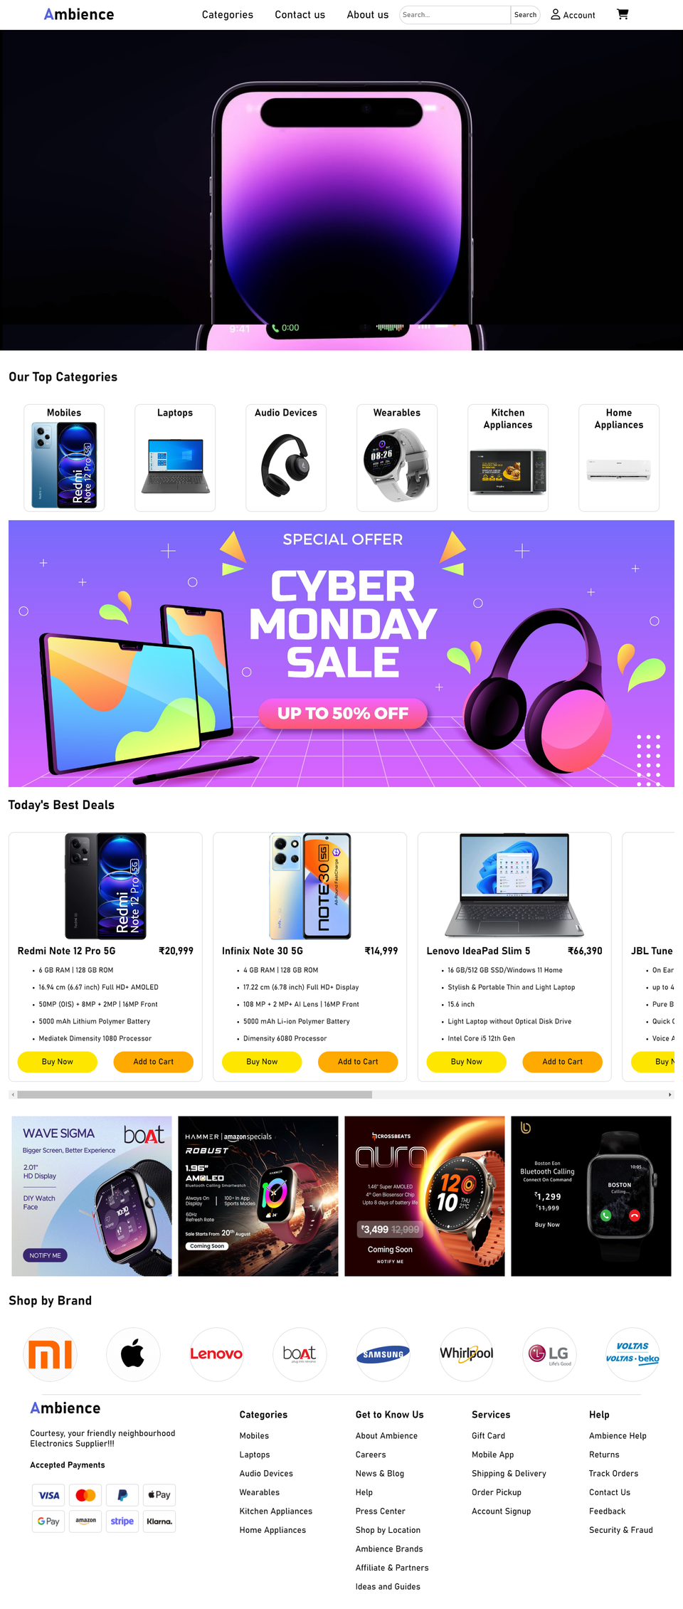

INTRODUCTION
This project was created using JavaScript, HTML, and CSS to demonstrate my ability to design a user-friendly and visually appealing website.
My primary focus was on delivering an exceptional user experience while applying best practices in front-end development.
It reflects my dedication to web development and showcases my problem-solving skills.
In the following sections, we'll delve into the project's features and technologies used to bring it to life. Thank you for joining us on this journey through our project.

Slide 4




WHY WAS THIS NAME CHOSEN?
The choice of the name Ambience can be influenced by several factors:
Atmosphere and Environment
Brand Identity
Memorability
Broad Appeal
Positive Connotations
Availability

Slide 5



GOALS
Design a streamlined and secure checkout process with multiple payment options, guest checkout feature, and real-time order tracking, minimizing cart abandonment and ensuring a smooth transaction flow.
·Develop a responsive and user-friendly interface that allows customers to easily browse products, view details, and make purchases, ensuring a seamless experience on both desktop and mobile devices.
·Present products in an appealing and organized manner, including high-quality images, detailed descriptions, and customer reviews, enhancing the overall shopping experience.

Slide 6
Challenges
Ensuring the website functions correctly and appears consistent across different web browsers (Chrome, Firefox, Safari, etc.) can be challenging due to varying rendering engines and standards.
1.
Designing a responsive layout that adapts seamlessly to various screen sizes and orientations, including smartphones, tablets, and desktops, requires careful planning and testing.
2.
Handling and displaying a large volume of product data, including images, descriptions, prices, and customer reviews, while maintaining website performance can be challenging.
3.
Integrating third-party services such as payment gateways, shipping providers, and customer relationship management (CRM) systems, while ensuring smooth communication and data exchange, can pose integration challenges.
4.
·Keeping the HTML, CSS, and JavaScript codebase organized, scalable, and maintainable, especially as the project grows, is crucial to facilitate future updates and additions.
5.

Slide 7
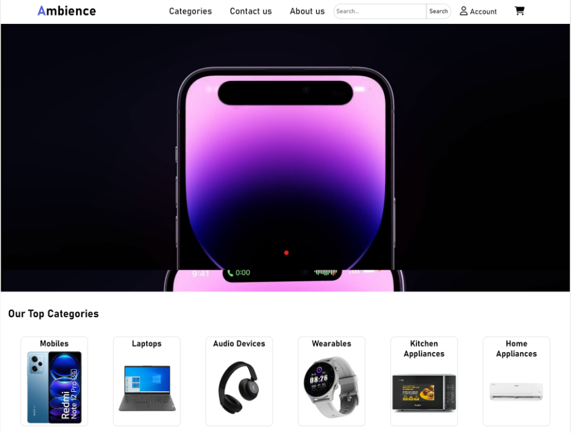
Project Overview
In the project that has been shown below, I have tried to create a website using HTML, CSS and JavaScript with a clean user interface which provides an easy shopping and exploring experience for the user. A YouTube button is given to every product which provides the user the review about the product conveniently. Colour and aesthetics of site has been kept simple and minimal to further increase user appeal. Different category pages are made for easier browsing to find your favourite in a nick of a time.

Slide 8
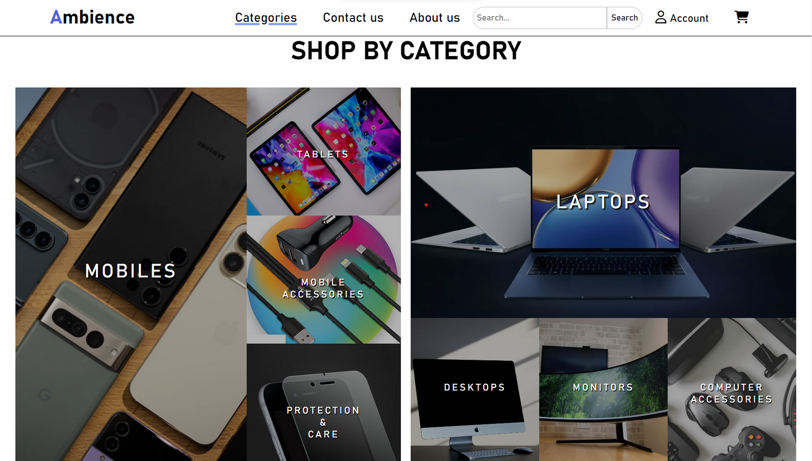
Category Page

Slide 9
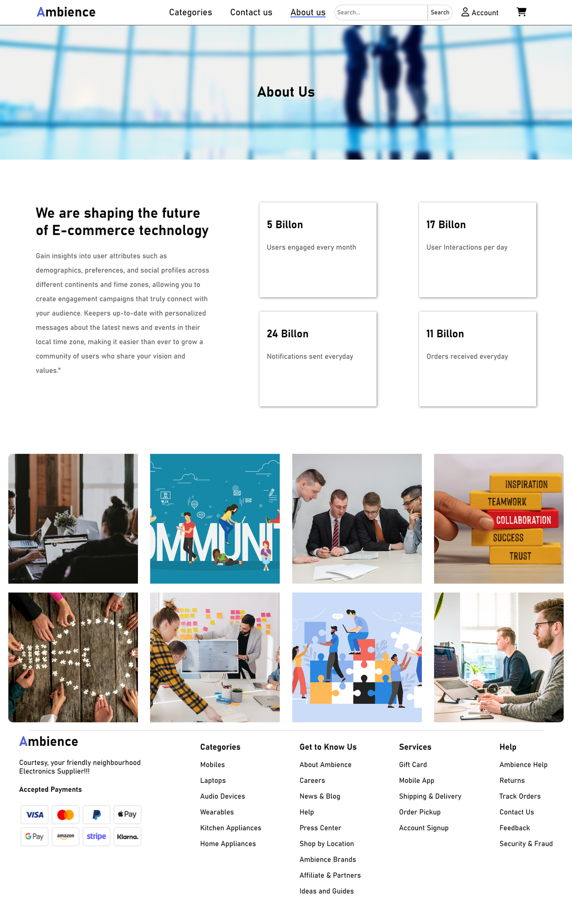
About us Page

Slide 10
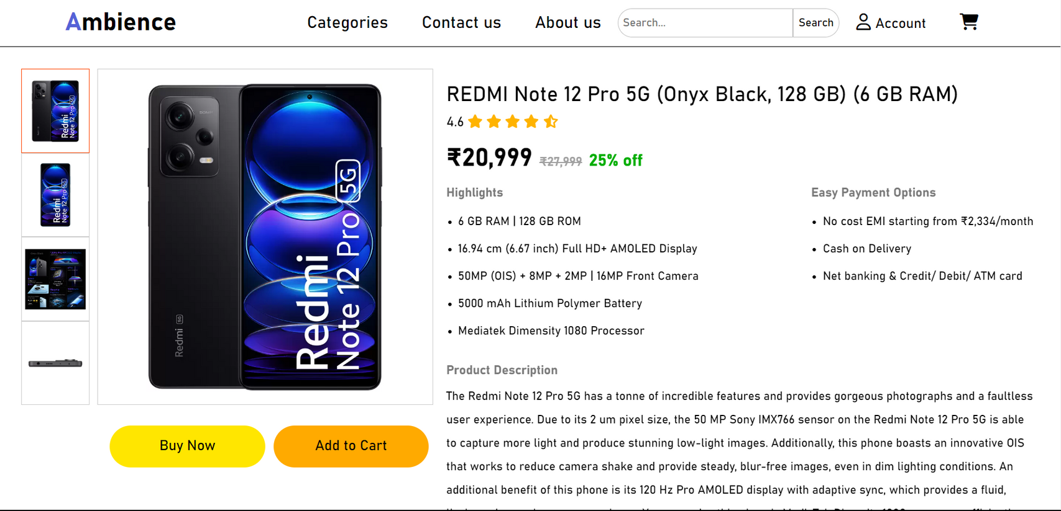
Single Product Page

Slide 11
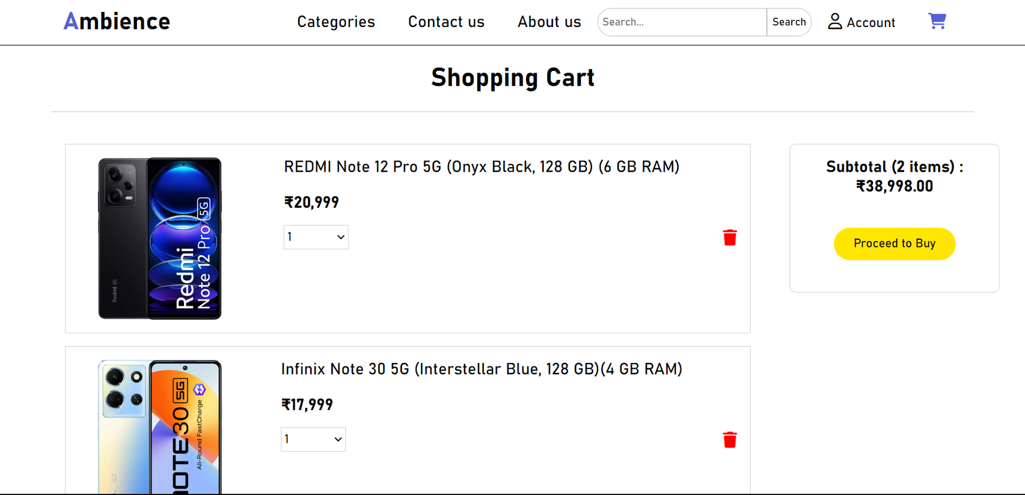
Shopping Cart Page

Slide 12
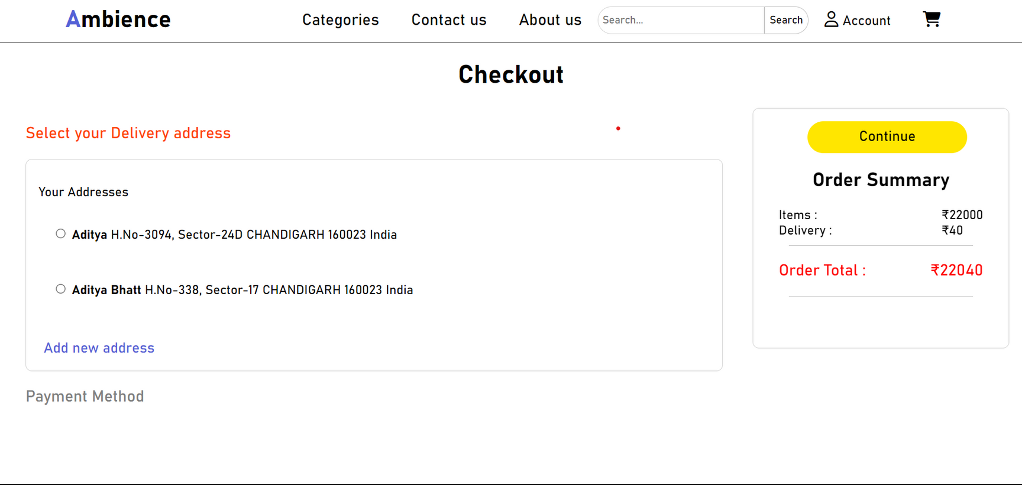
Checkout Page

Slide 13



FUTURE SCOPE
Develop cross-selling and upselling strategies to increase the average order value by recommending related products or premium versions.
Utilize advanced analytics tools to gain insights into user behaviour, sales patterns, and inventory management, which can guide business decisions.
Integrating social media features to allow users to discover products through social networks, share their purchases, and interact with our brand on social platforms.

Slide 14
E-Commerce Website
Thank You

